Slide 1


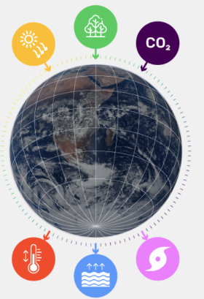



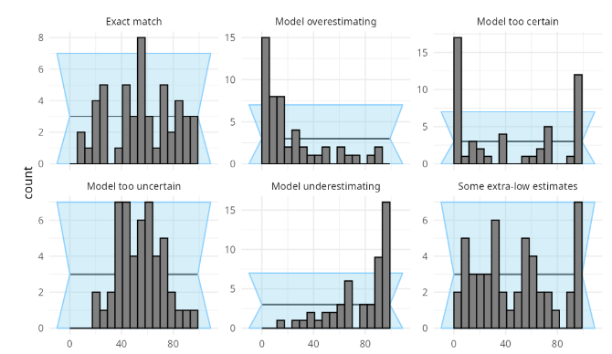
Simulation-Based Inference (SBI)
Heebah Saleem¹, Sergey Alyaev², Nello Blaser¹, Kristian Fossum²
¹University of Bergen | ²NORCE
1. Motivation
2. SBI Setup
3. Why SBI?
Many scientific problems involve complex simulators where the likelihood p(x|Ө) is unavailable
E.g., climate models, geological subsurface, astrophysics
SBI allows inferring model parameters from simulated data without evaluating the likelihood
Enables uncertainty quantification and better decision-making
Model Parameter ө
Simulator S(ө)
Simulated data x
Works when likelihood is expensive
Applicable to complex simulators
Supports full posterior distributions
Widely used in many domains e.g. climate, geology, physics etc
Given observed data x_{obs}, we want to infer the posterior distribution over the parameters:
p(ө | x_{obs})
using only simulations and without evaluating p(x|Ө)
4. Amortized Bayesian Inference with BayesFlow
1. Prior
ө ~ p (ө)
2. Simulate
x ~ S(ө)
3. Train Neural Network (BayesFlow)
Learning Mapping
x → p(ө | x)
4. Posterior
p(ө | x_{obs})
5. Tutorial Components from ProbAI BayesFlow
Part 1: Linear Regression
Linear regression model with simulator
Compared conventional Bayesian inference with amortized inference (BF)
Check inferred posteriors matches
Objective: Demonstrate how amortized neural networks can learn to perform Bayesian Inference and then be reused efficiently for new observations
Part 2: Susceptible, Infected or Recovered, and Diagnostics
More complex simulator from system
Learn informative statistics using GRU network
Infer posteriors distribution for multiple parameters
Evaluates inference quality: Rank histogram, coverage, posterior predictive checks etc.
Part 3: Diffusion Guidance
DM can be used as neural posteriors estimators
Handles complex posteriors effectively
Guidance allows conditioning on additional information during sampling
Shows how diffusion-based posterior inference can improve performance in SBI
6. Simulation-Based Calibration (SBC)
7. Diffusion Posterior and Guidance
Checks whether the inferred posteriors are well calibrated
Run multiple simulations, infer posteriors, and evaluate rank statistics
A calibrated method gives a uniform distribution
Rank Histograms
Diffusion Models can learn flexible posterior distributions for complex simulators
Guidance allows conditioning on additional information or constraints
Useful for high-dimensional and multi-modal posteriors
heebah.saleem@uib.no | PhD Research Fellow | UiB

